Slide 1
LALP PART -2
Dr. Pradeep.J.Jha

Slide 2
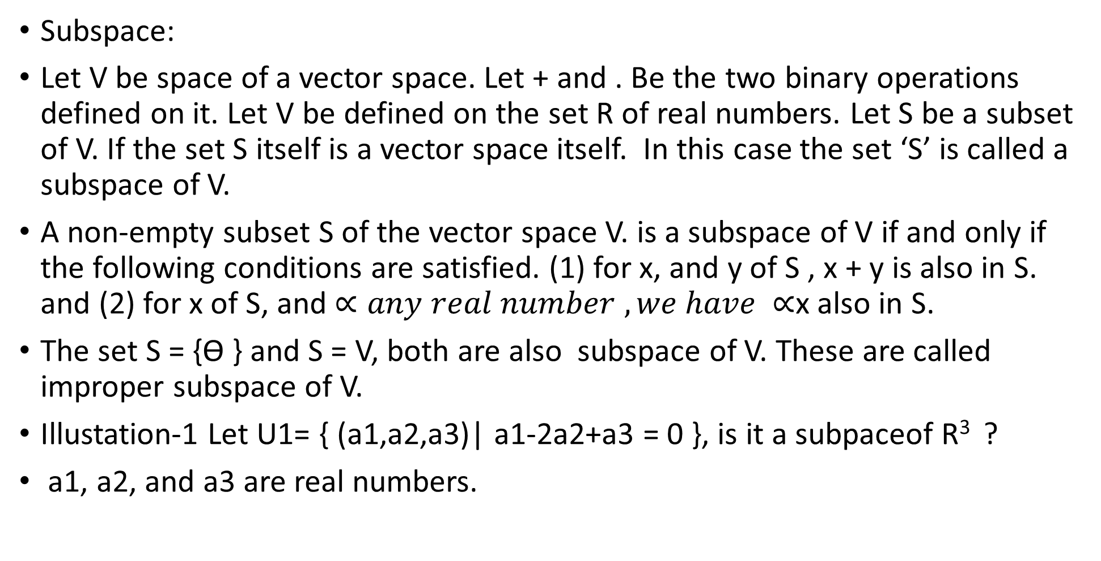
LALP PART 2.1
Subspace:
Let V be space of a vector space. Let + and . Be the two binary operations defined on it. Let V be defined on the set R of real numbers. Let S be a subset of V. If the set S itself is a vector space itself. In this case the set ‘S’ is called a subspace of V.
A non-empty subset S of the vector space V. is a subspace of V if and only if the following conditions are satisfied. (1) for x, and y of S , x + y is also in S. and (2) for x of S, and $∝any real number , we have$ $∝$x also in S.
The set S = {ϴ } and S = V, both are also subspace of V. These are called improper subspace of V.
Illustation-1 Let U1= { (a1,a2,a3)| a1-2a2+a3 = 0 }, is it a subpaceof R³ ?
a1, a2, and a3 are real numbers.

Slide 3
LALP PART 2.3
Facts:
1 That two vectors of R² can be linearly independent or dependent. This
depends on condition of independency or dependency. S1= { (1,2), (3,4) },
S2 ={(1,0), (0,1)}, S3 = { (3,-4), (2,6), S4 ={ (5, 15), (1,3)}, which are L.D ?
More than two diferent vectors of R² are linearly dependent if any two of them are linearly independent. E.g. { (1,2), (3,4), (1,7)} are linearly dependent as any two of them are linearly independent. S2 = { (3,4) ,(2,4) , (5,-7)} are linearly dependent[(3,4) = c1(2,4) + c2 (5,-7) ; we can find c1 and c2 which are other than zero.
In the same way we can state for the vectors of R³.
A Basis is a set of basic vectors. Standard basic vectors are { (1,0), (0,1)}
(6,8) = 6(1,0) + 8 (0,1)= 6i + 8j, |i| = |j| =1

Slide 4
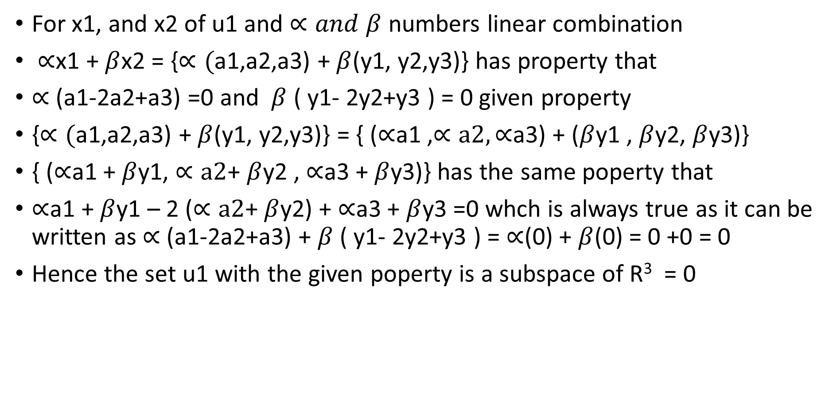
LALP PART 2.2
For x1, and x2 of u1 and $∝and$ $β$ numbers linear combination
$∝$x1 + $β$x2 = {$∝($a1,a2,a3) + $β$(y1, y2,y3)} has property that
$∝$ (a1-2a2+a3) =0 and $β$ ( y1- 2y2+y3 ) = 0 given property
{$∝($a1,a2,a3) + $β$(y1, y2,y3)} = { ($∝$a1 ,$∝a2,∝$a3) + ($β$y1 , $β$y2, $β$y3)}
{ ($∝$a1 + $β$y1, $∝a2$+ $β$y2 , $∝$a3 + $β$y3)} has the same poperty that
$∝$a1 + $β$y1 – 2 ($∝a2$+ $β$y2) + $∝$a3 + $β$y3 =0 whch is always true as it can be written as $∝$ (a1-2a2+a3) + $β$ ( y1- 2y2+y3 ) = $∝$(0) + $β$(0) = 0 +0 = 0
Hence the set u1 with the given poperty is a subspace of R³ = 0

Slide 5
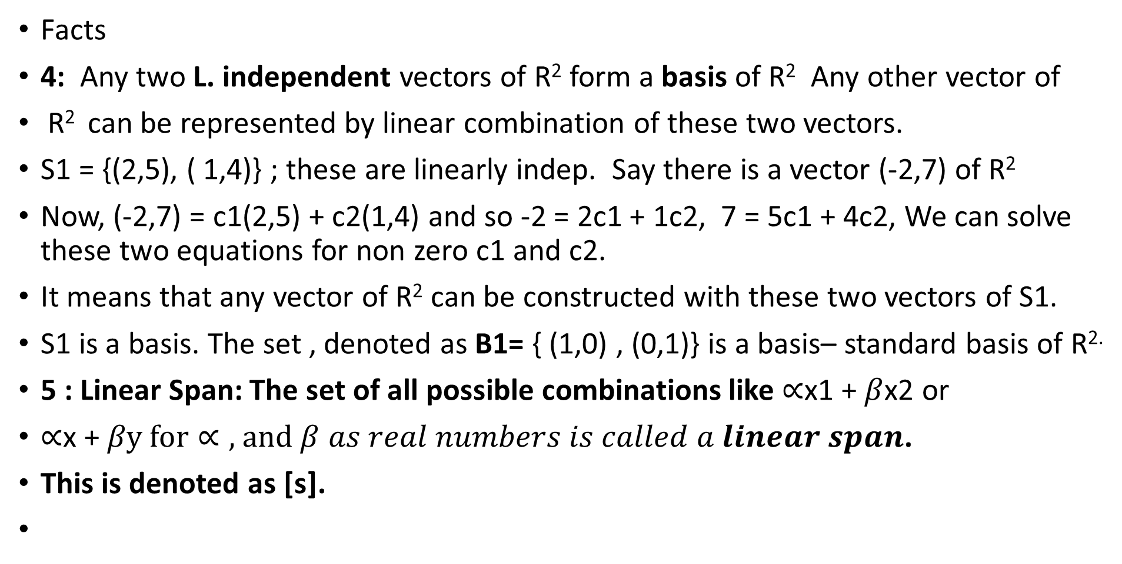
LALP PART 2.4
Facts
4: Any two L. independent vectors of R² form a basis of R² Any other vector of
R² can be represented by linear combination of these two vectors.
S1 = {(2,5), ( 1,4)} ; these are linearly indep. Say there is a vector (-2,7) of R²
Now, (-2,7) = c1(2,5) + c2(1,4) and so -2 = 2c1 + 1c2, 7 = 5c1 + 4c2, We can solve these two equations for non zero c1 and c2.
It means that any vector of R² can be constructed with these two vectors of S1.
S1 is a basis. The set , denoted as B1= { (1,0) , (0,1)} is a basis– standard basis of R^{2.}
5 : Linear Span: The set of all possible combinations like $∝$x1 + $β$x2 or
$∝$x + $βy for∝\text{, }\text{and} β as real numbers is called a linear span$.
This is denoted as [s].

Slide 6
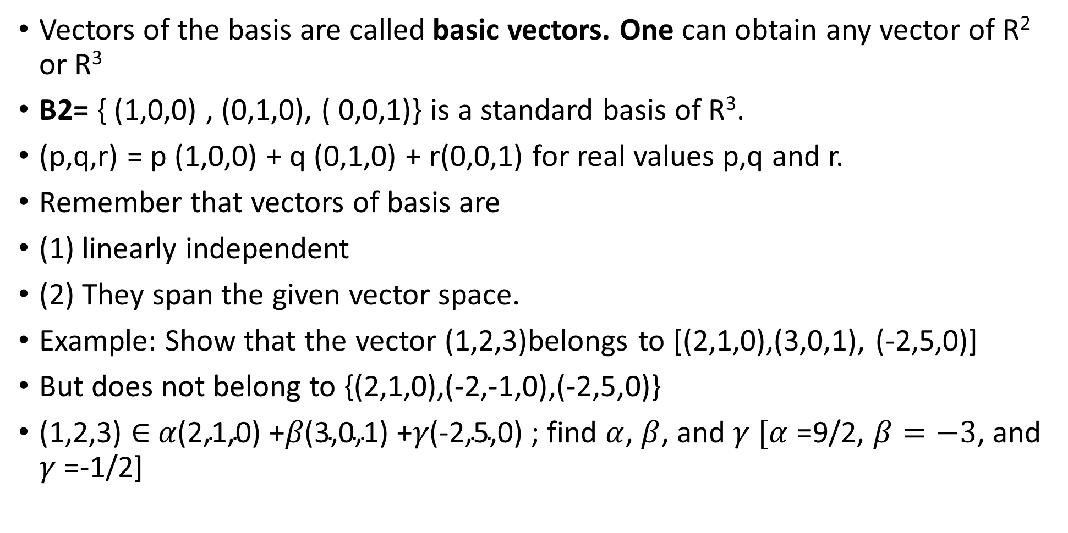
LALP 2.5
Vectors of the basis are called basic vectors. One can obtain any vector of R² or R³
B2= { (1,0,0) , (0,1,0), ( 0,0,1)} is a standard basis of R³.
(p,q,r) = p (1,0,0) + q (0,1,0) + r(0,0,1) for real values p,q and r.
Remember that vectors of basis are
(1) linearly independent
(2) They span the given vector space.
Example: Show that the vector (1,2,3)belongs to [(2,1,0),(3,0,1), (-2,5,0)]
But does not belong to {(2,1,0),(-2,-1,0),(-2,5,0)}
(1,2,3) $∈$ $α\text{(2,1,0)}$ +$β\text{(3,0,1)}$ +$γ\text{(−2,5,0)}$ ; find $α$, $β$, and $γ [α$ =9/2, $β=−3$, and $γ$ =-1/2]

Slide 7
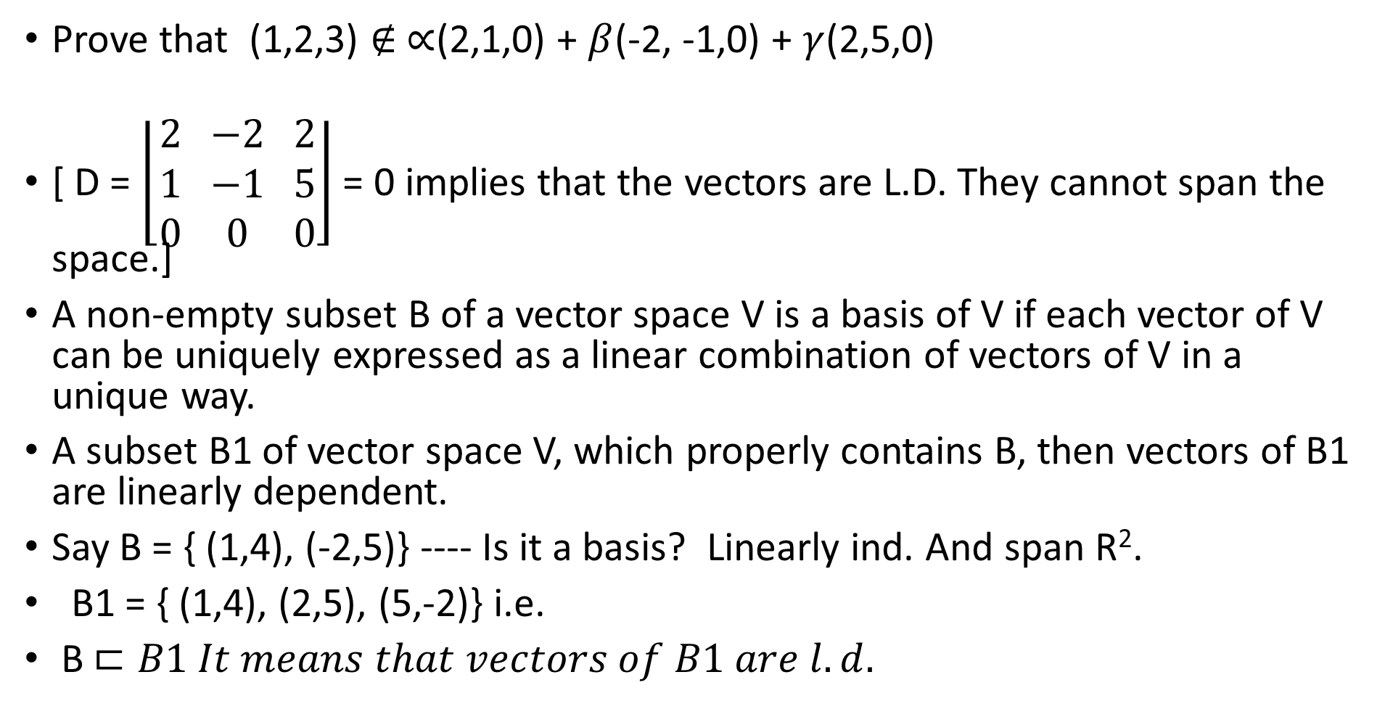
LALP 2.6
Prove that (1,2,3) $∉ ∝$(2,1,0) + $β$(-2, -1,0) + $γ$(2,5,0)
[ D = $\left\lfloor \begin{matrix}2 \\ 1 \\ 0\end{matrix} \begin{matrix}−2 \\ −1 \\ 0\end{matrix} \begin{matrix}2 \\ 5 \\ 0\end{matrix}\right\rfloor$ = 0 implies that the vectors are L.D. They cannot span the space.]
A non-empty subset B of a vector space V is a basis of V if each vector of V can be uniquely expressed as a linear combination of vectors of V in a unique way.
A subset B1 of vector space V, which properly contains B, then vectors of B1 are linearly dependent.
Say B = { (1,4), (-2,5)} ---- Is it a basis? Linearly ind. And span R².
B1 = { (1,4), (2,5), (5,-2)} i.e.
B $⊏B1 It means that vectors of B1 are l.d.$

Slide 8
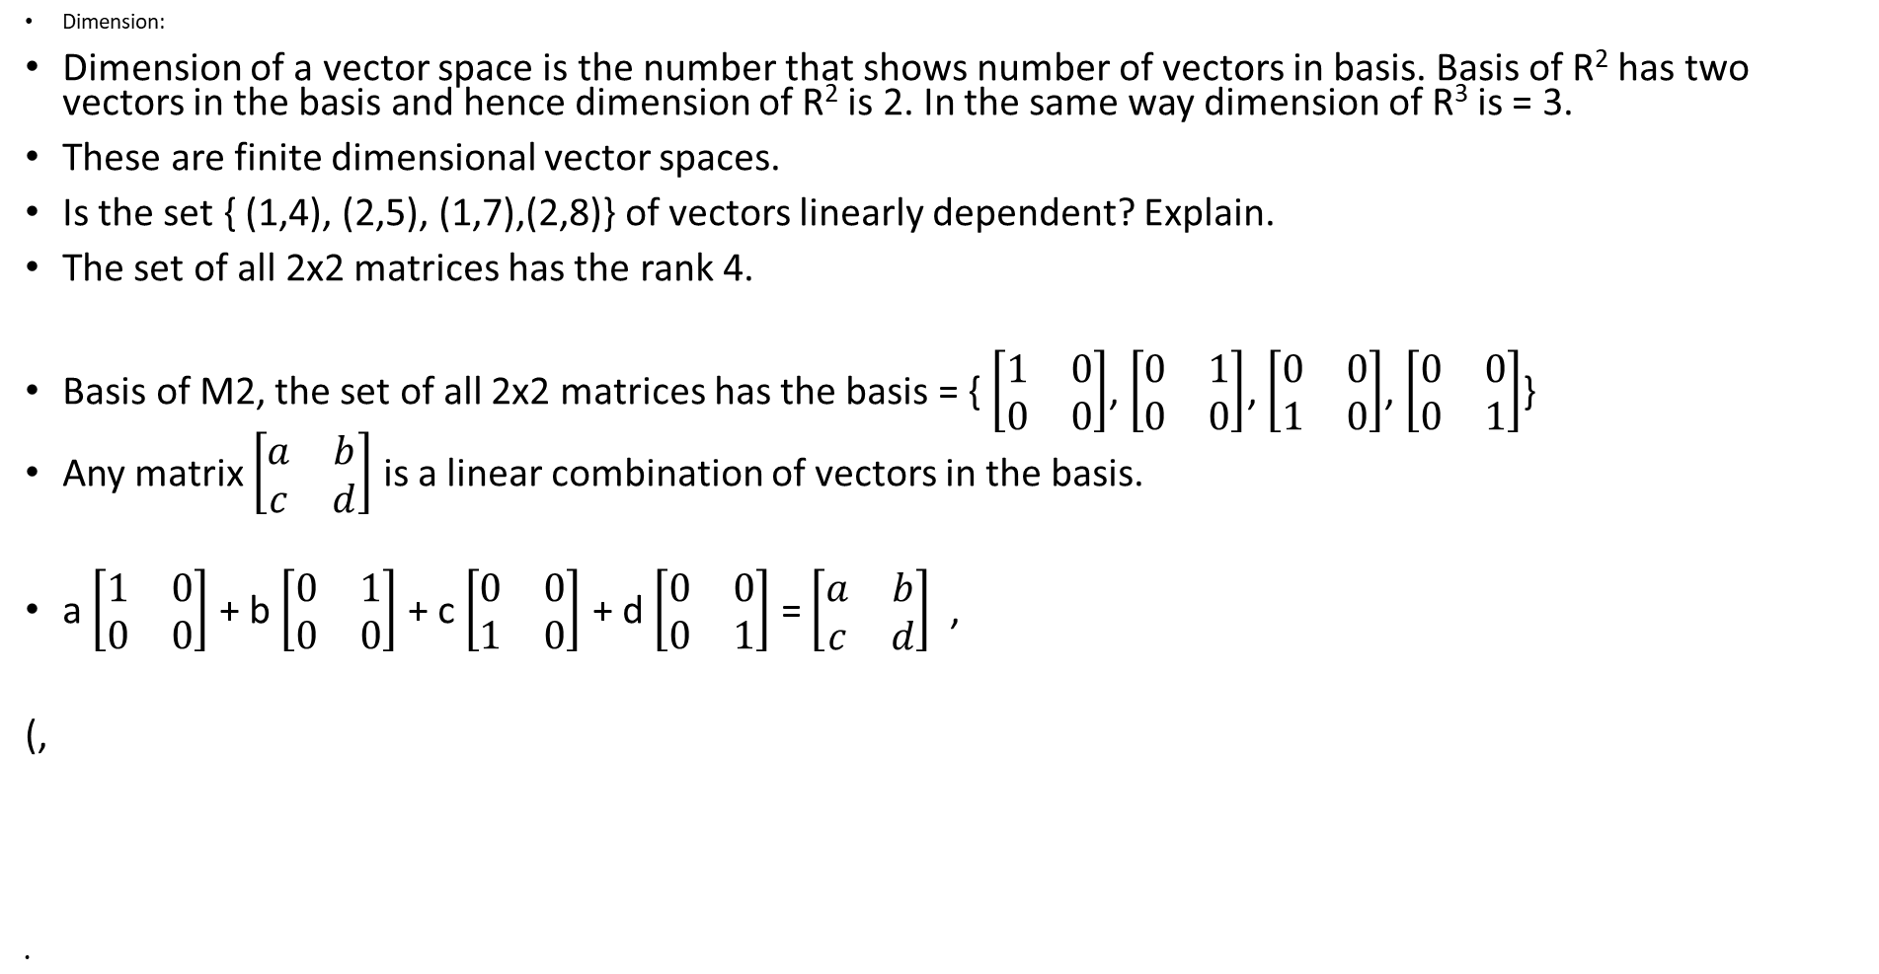
LALP 2.7
Dimension:
Dimension of a vector space is the number that shows number of vectors in basis. Basis of R² has two vectors in the basis and hence dimension of R² is 2. In the same way dimension of R³ is = 3.
These are finite dimensional vector spaces.
Is the set { (1,4), (2,5), (1,7),(2,8)} of vectors linearly dependent? Explain.
The set of all 2x2 matrices has the rank 4.
Basis of M2, the set of all 2x2 matrices has the basis = { $\left[\begin{matrix}1 & 0 \\ 0 & 0\end{matrix}\right]$, $\left[\begin{matrix}0 & 1 \\ 0 & 0\end{matrix}\right]$, $\left[\begin{matrix}0 & 0 \\ 1 & 0\end{matrix}\right]$, $\left[\begin{matrix}0 & 0 \\ 0 & 1\end{matrix}\right]$}
Any matrix $\left[\begin{matrix}a & b \\ c & d\end{matrix}\right]$ is a linear combination of vectors in the basis.
a $\left[\begin{matrix}1 & 0 \\ 0 & 0\end{matrix}\right]$ + b $\left[\begin{matrix}0 & 1 \\ 0 & 0\end{matrix}\right]$ + c $\left[\begin{matrix}0 & 0 \\ 1 & 0\end{matrix}\right]$ + d $\left[\begin{matrix}0 & 0 \\ 0 & 1\end{matrix}\right]$ = $\left[\begin{matrix}a & b \\ c & d\end{matrix}\right]$ ,
(,

Slide 9

LALP 2.8
In the same way the vector space M₃ _{of} all 3x3 matrices have 9 elements( matrices ) in its basis. E.g. the matrix $\left[\begin{matrix}1 & 0 & 0 \\ 0 & 0 & 0 \\ 0 & 0 & 0\end{matrix}\right]$
Out of 9 entries one is 1 and others are zero. Any matrix of the space M₃ is a linear combination of all this nine matrices of the basis.
We can continue for higher dimensional spaces.

Slide 10
LALP 2.9
Back to L.T.
A transformation from one vector space U to the another vector space V, denoted as T: U V is called linear if for
X1 and x2 as members of U and c1 and c2 as constants, we have either
1 T(x1 + x2) = T(x1) + T (x2)
2 T (c1x1) = c1 T( x1)
or
T( c1x1 + c2x2) = c1T(x1) + c2 T(x2)
Illustration: Let T: R² R² so that for (a,b) of R² T(a,b) = ( 2a +b, a-b)

Slide 11
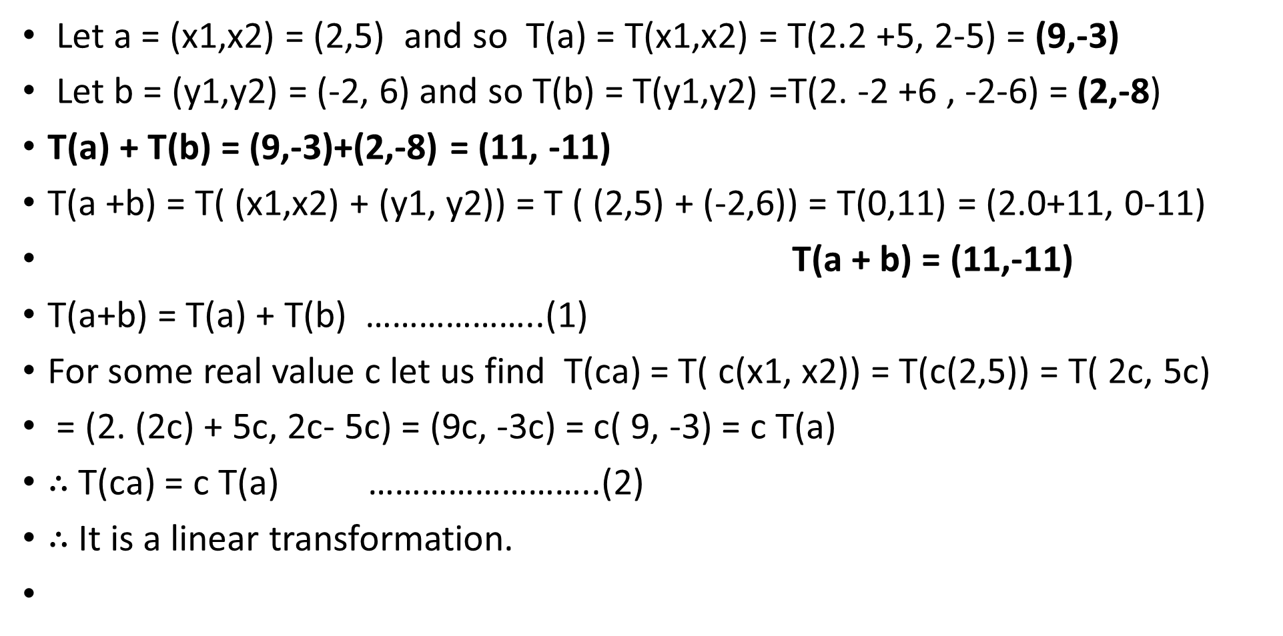
LALP 2.10
Let a = (x1,x2) = (2,5) and so T(a) = T(x1,x2) = T(2.2 +5, 2-5) = (9,-3)
Let b = (y1,y2) = (-2, 6) and so T(b) = T(y1,y2) =T(2. -2 +6 , -2-6) = (2,-8)
T(a) + T(b) = (9,-3)+(2,-8) = (11, -11)
T(a +b) = T( (x1,x2) + (y1, y2)) = T ( (2,5) + (-2,6)) = T(0,11) = (2.0+11, 0-11)
T(a + b) = (11,-11)
T(a+b) = T(a) + T(b) ………………..(1)
For some real value c let us find T(ca) = T( c(x1, x2)) = T(c(2,5)) = T( 2c, 5c)
= (2. (2c) + 5c, 2c- 5c) = (9c, -3c) = c( 9, -3) = c T(a)
$∴$ T(ca) = c T(a) ……………………..(2)
$∴$ It is a linear transformation.

Slide 12
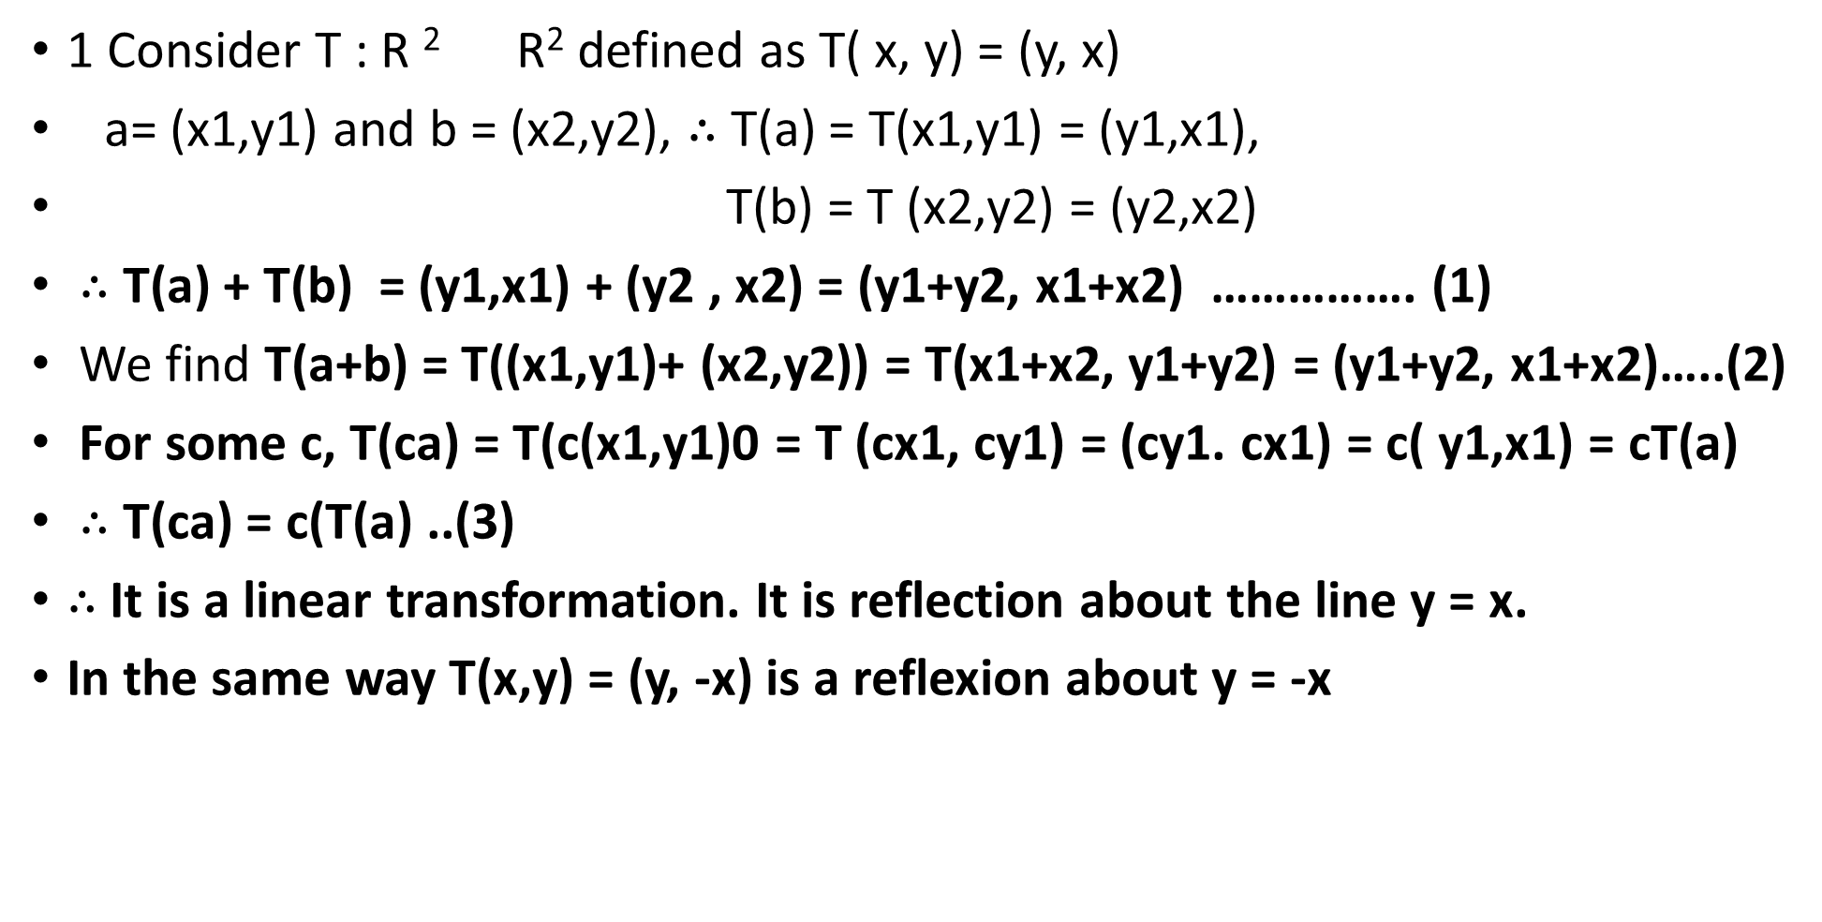
LALP 2.11
1 Consider T : R ² R² defined as T( x, y) = (y, x)
a= (x1,y1) and b = (x2,y2), $∴$ T(a) = T(x1,y1) = (y1,x1),
T(b) = T (x2,y2) = (y2,x2)
$∴$ T(a) + T(b) = (y1,x1) + (y2 , x2) = (y1+y2, x1+x2) ……………. (1)
We find T(a+b) = T((x1,y1)+ (x2,y2)) = T(x1+x2, y1+y2) = (y1+y2, x1+x2)…..(2)
For some c, T(ca) = T(c(x1,y1)0 = T (cx1, cy1) = (cy1. cx1) = c( y1,x1) = cT(a)
$∴$ T(ca) = c(T(a) ..(3)
$∴$ It is a linear transformation. It is reflection about the line y = x.
In the same way T(x,y) = (y, -x) is a reflexion about y = -x

Slide 13
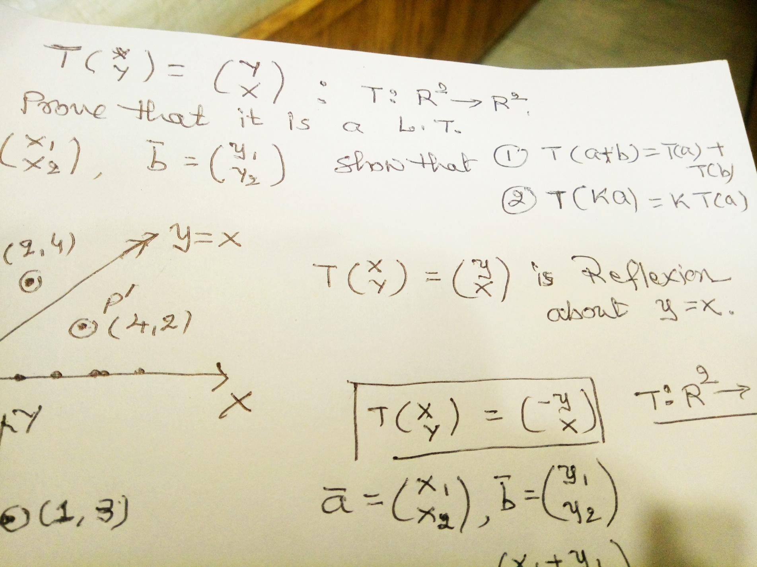
Lalp2.12

Slide 14
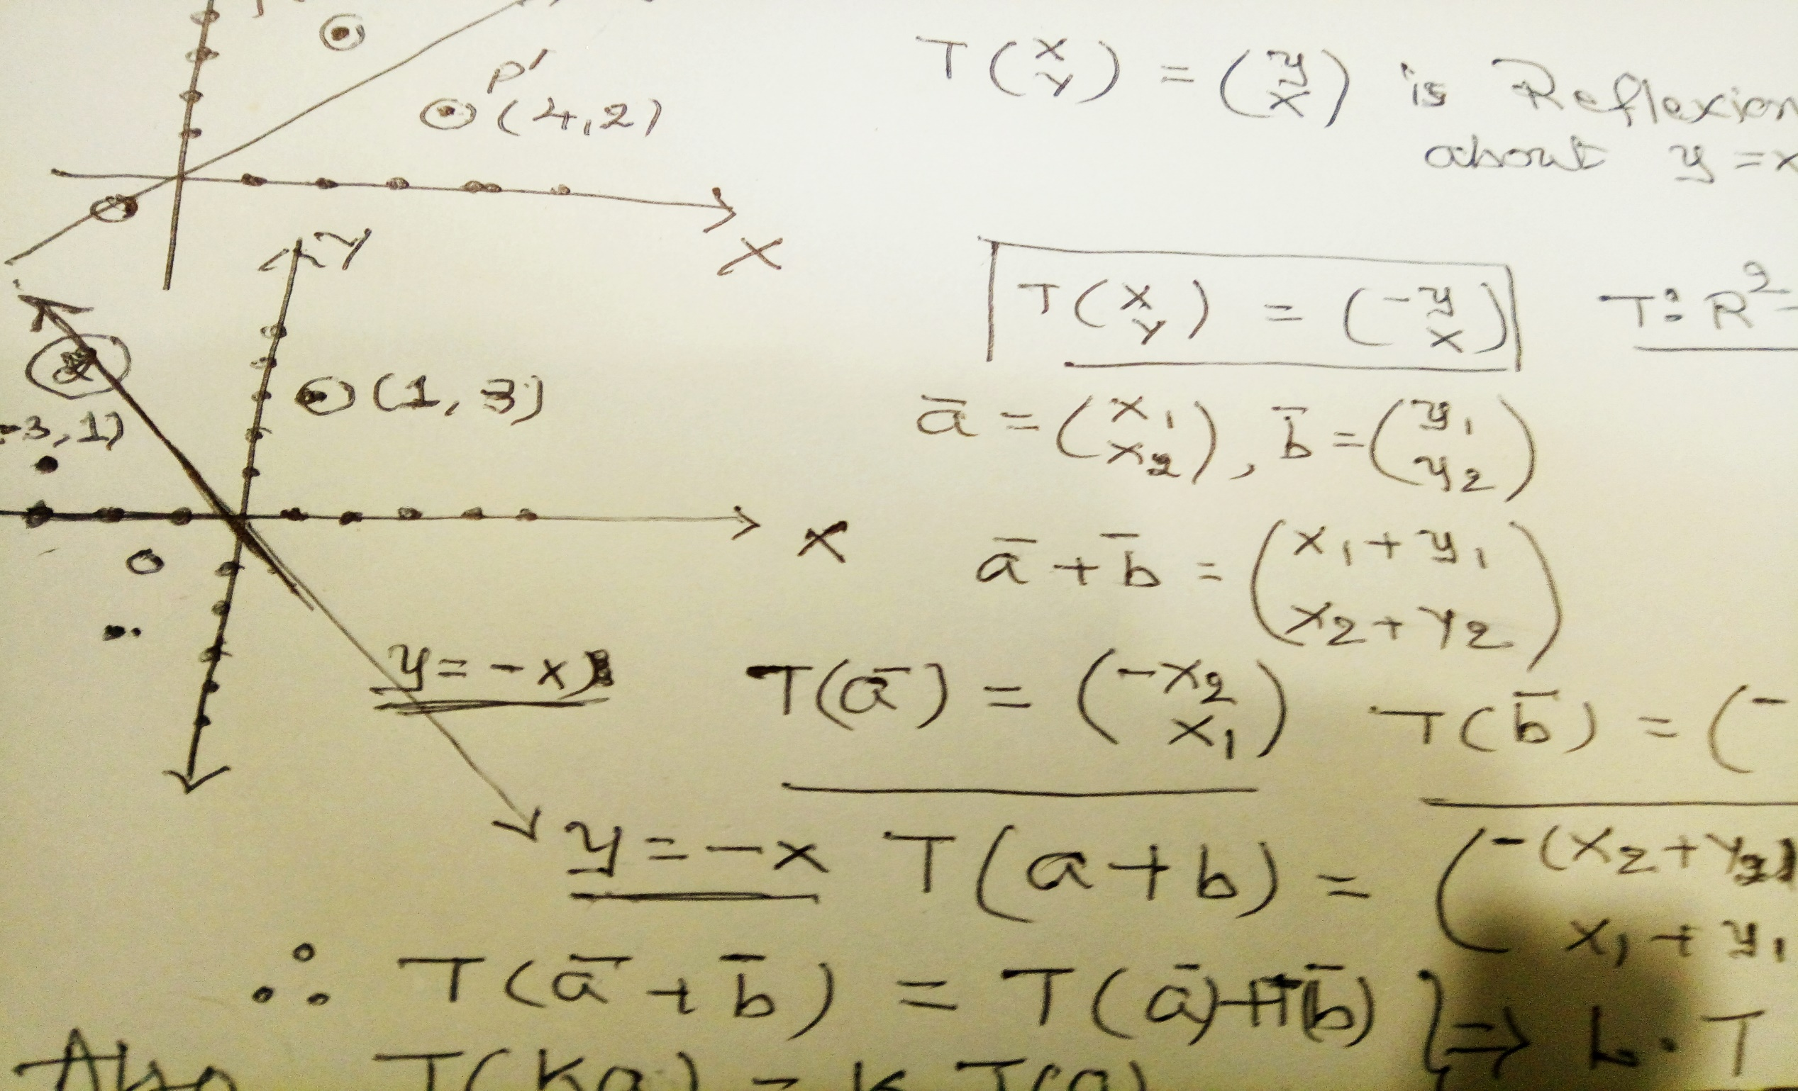
LALP 2.14

Slide 15
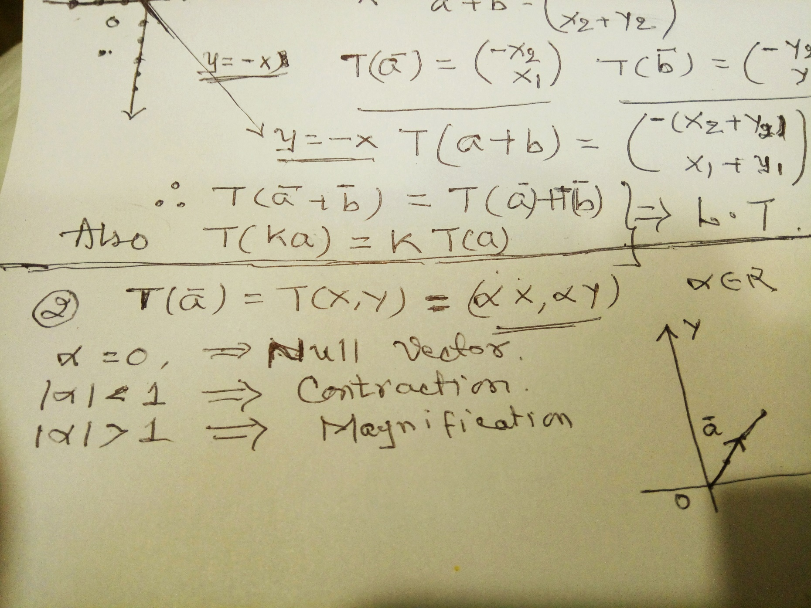
LALP13

Slide 16
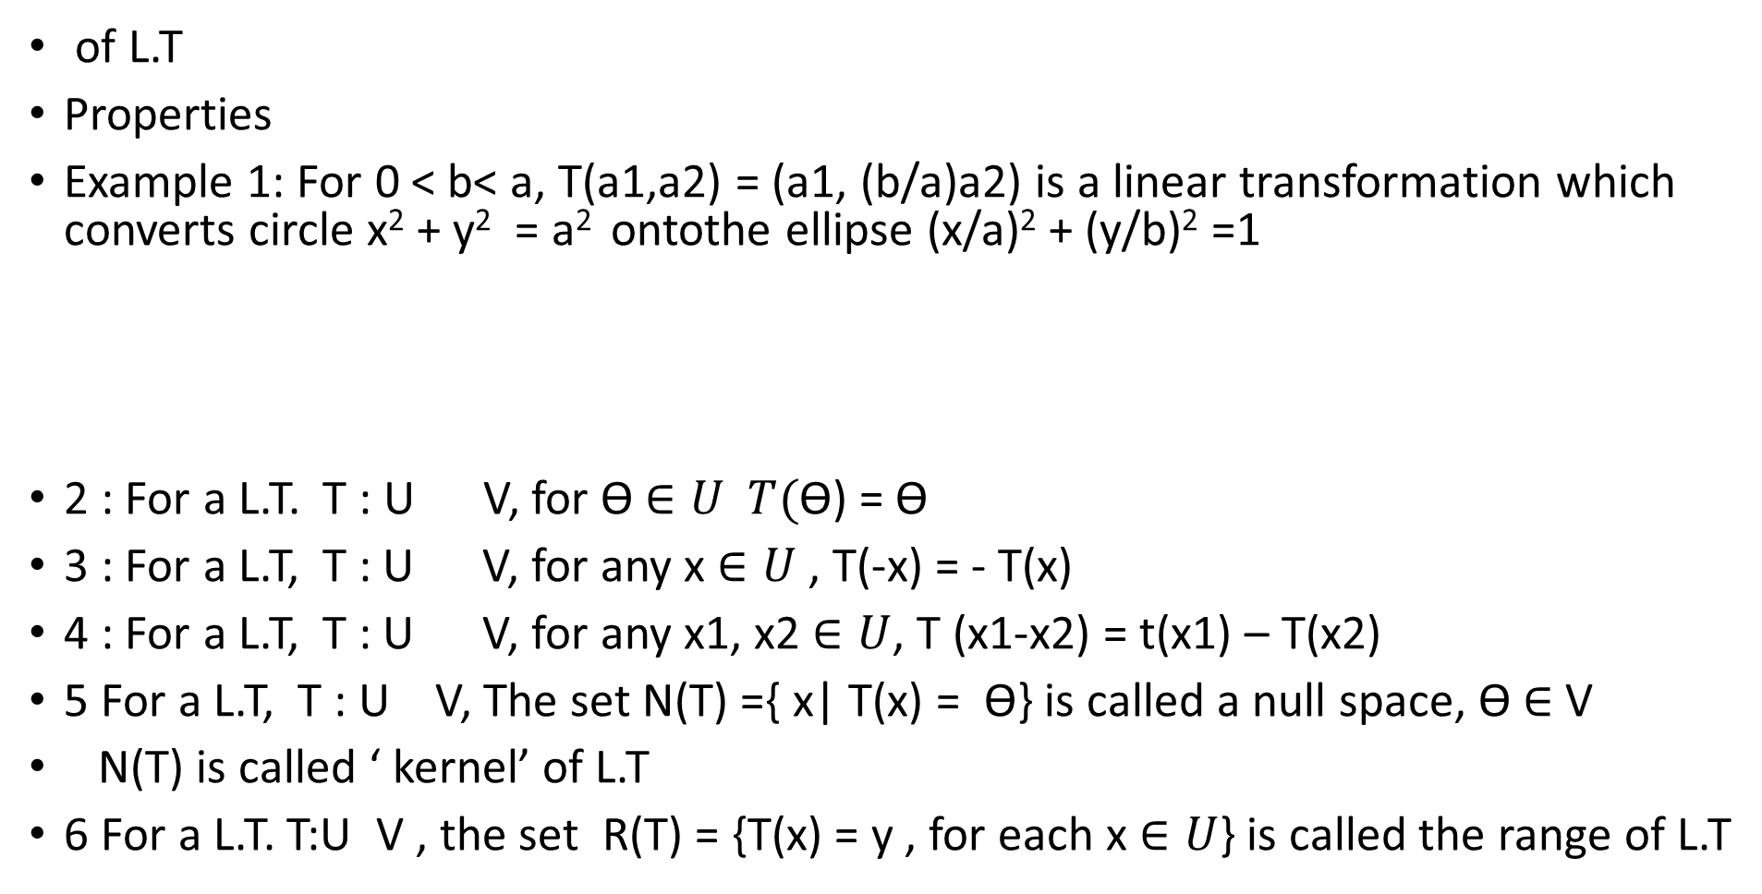
LALP 2.15
of L.T
Properties
Example 1: For 0 < b< a, T(a1,a2) = (a1, (b/a)a2) is a linear transformation which converts circle x² + y² = a² ontothe ellipse (x/a)² + (y/b)² =1
2 : For a L.T. T : U V, for ϴ $∈U T(\text{ϴ}$) = ϴ
3 : For a L.T, T : U V, for any x $∈U$ , T(-x) = - T(x)
4 : For a L.T, T : U V, for any x1, x2 $∈U$, T (x1-x2) = t(x1) – T(x2)
5 For a L.T, T : U V, The set N(T) ={ x| T(x) = ϴ} is called a null space, ϴ $∈$ V
N(T) is called ‘ kernel’ of L.T
6 For a L.T. T:U V , the set R(T) = {T(x) = y , for each x $∈U$} is called the range of L.T

Slide 17
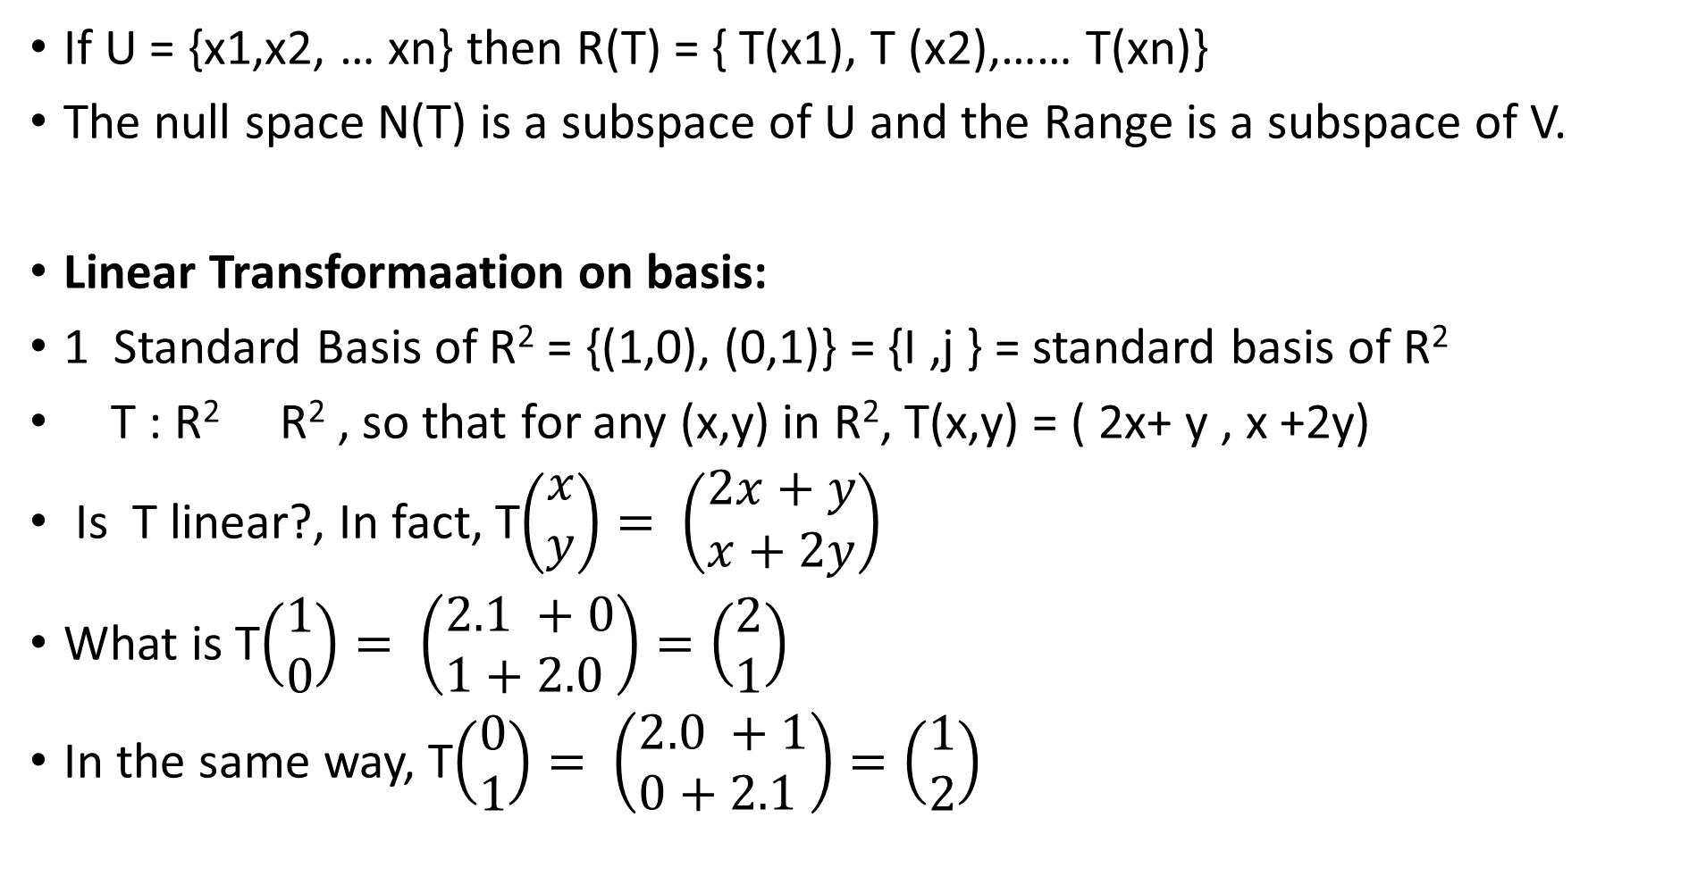
LALP 2.16
If U = {x1,x2, … xn} then R(T) = { T(x1), T (x2),…… T(xn)}
The null space N(T) is a subspace of U and the Range is a subspace of V.
Linear Transformaation on basis:
1 Standard Basis of R² = {(1,0), (0,1)} = {I ,j } = standard basis of R²
T : R² R² , so that for any (x,y) in R², T(x,y) = ( 2x+ y , x +2y)
Is T linear?, In fact, T$\left(\begin{matrix}x \\ y\end{matrix}\right)= \left(\begin{matrix}2x+y \\ x+2y\end{matrix}\right)$
What is T$\left(\begin{matrix}1 \\ 0\end{matrix}\right)= \left(\begin{matrix}2.1 +0 \\ 1+2.0 \end{matrix}\right)=\left(\begin{matrix}2 \\ 1\end{matrix}\right)$
In the same way, T$\left(\begin{matrix}0 \\ 1\end{matrix}\right)= \left(\begin{matrix}2.0 +1 \\ 0+2.1 \end{matrix}\right)=\left(\begin{matrix}1 \\ 2\end{matrix}\right)$

Slide 18
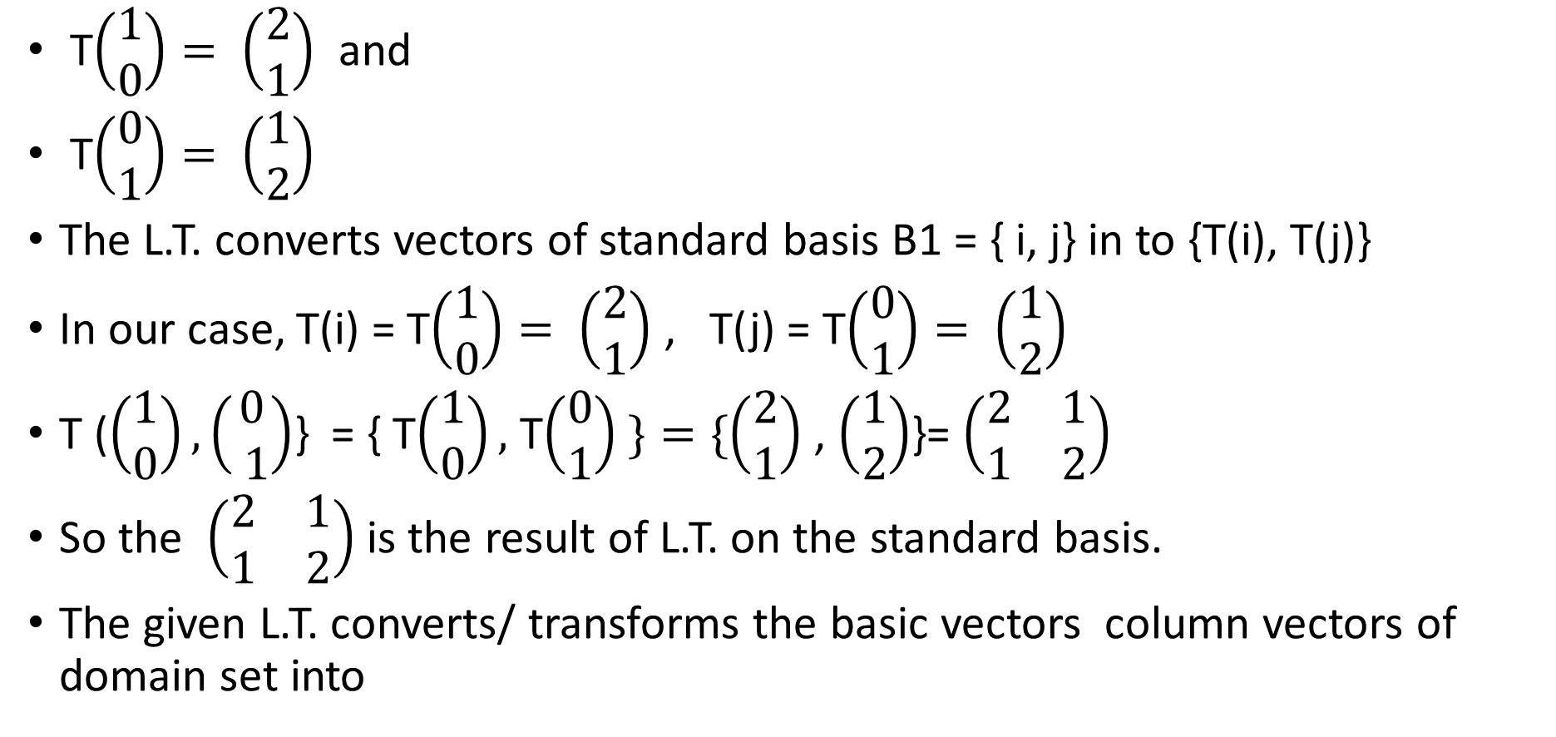
LALP 2.17
T$\left(\begin{matrix}1 \\ 0\end{matrix}\right)= \left(\begin{matrix}2 \\ 1\end{matrix}\right)$ and
T$\left(\begin{matrix}0 \\ 1\end{matrix}\right)= \left(\begin{matrix}1 \\ 2\end{matrix}\right)$
The L.T. converts vectors of standard basis B1 = { i, j} in to {T(i), T(j)}
In our case, T(i) = T$\left(\begin{matrix}1 \\ 0\end{matrix}\right)= \left(\begin{matrix}2 \\ 1\end{matrix}\right)$ , T(j) = T$\left(\begin{matrix}0 \\ 1\end{matrix}\right)= \left(\begin{matrix}1 \\ 2\end{matrix}\right)$
T ($\left(\begin{matrix}1 \\ 0\end{matrix}\right), \left(\begin{matrix}0 \\ 1\end{matrix}\right)$} = { T$\left(\begin{matrix}1 \\ 0\end{matrix}\right),$ T$\left(\begin{matrix}0 \\ 1\end{matrix}\right) \}=\{\left(\begin{matrix}2 \\ 1\end{matrix}\right)$ , $\left(\begin{matrix}1 \\ 2\end{matrix}\right)$}= $\left(\begin{matrix}2 & 1 \\ 1 & 2\end{matrix}\right)$
So the $\left(\begin{matrix}2 & 1 \\ 1 & 2\end{matrix}\right)$ is the result of L.T. on the standard basis.
The given L.T. converts/ transforms the basic vectors column vectors of domain set into

Slide 19
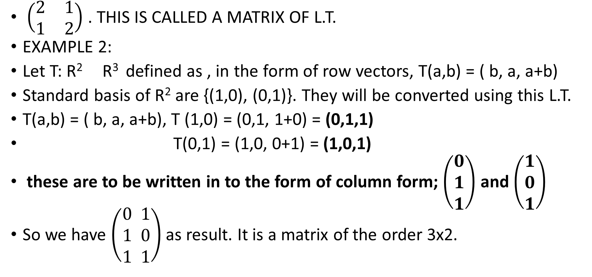
LALP 2.18
$\left(\begin{matrix}2 & 1 \\ 1 & 2\end{matrix}\right)$ . THIS IS CALLED A MATRIX OF L.T.
EXAMPLE 2:
Let T: R² R³ defined as , in the form of row vectors, T(a,b) = ( b, a, a+b)
Standard basis of R² are {(1,0), (0,1)}. They will be converted using this L.T.
T(a,b) = ( b, a, a+b), T (1,0) = (0,1, 1+0) = (0,1,1)
T(0,1) = (1,0, 0+1) = (1,0,1)
these are to be written in to the form of column form; $\left(\begin{matrix}0 \\ 1 \\ 1\end{matrix}\right)$ and $\left(\begin{matrix}1 \\ 0 \\ 1\end{matrix}\right)$
So we have $\left(\begin{matrix}0 \\ 1 \\ 1\end{matrix} \begin{matrix}1 \\ 0 \\ 1\end{matrix}\right)$ as result. It is a matrix of the order 3x2.

Slide 20
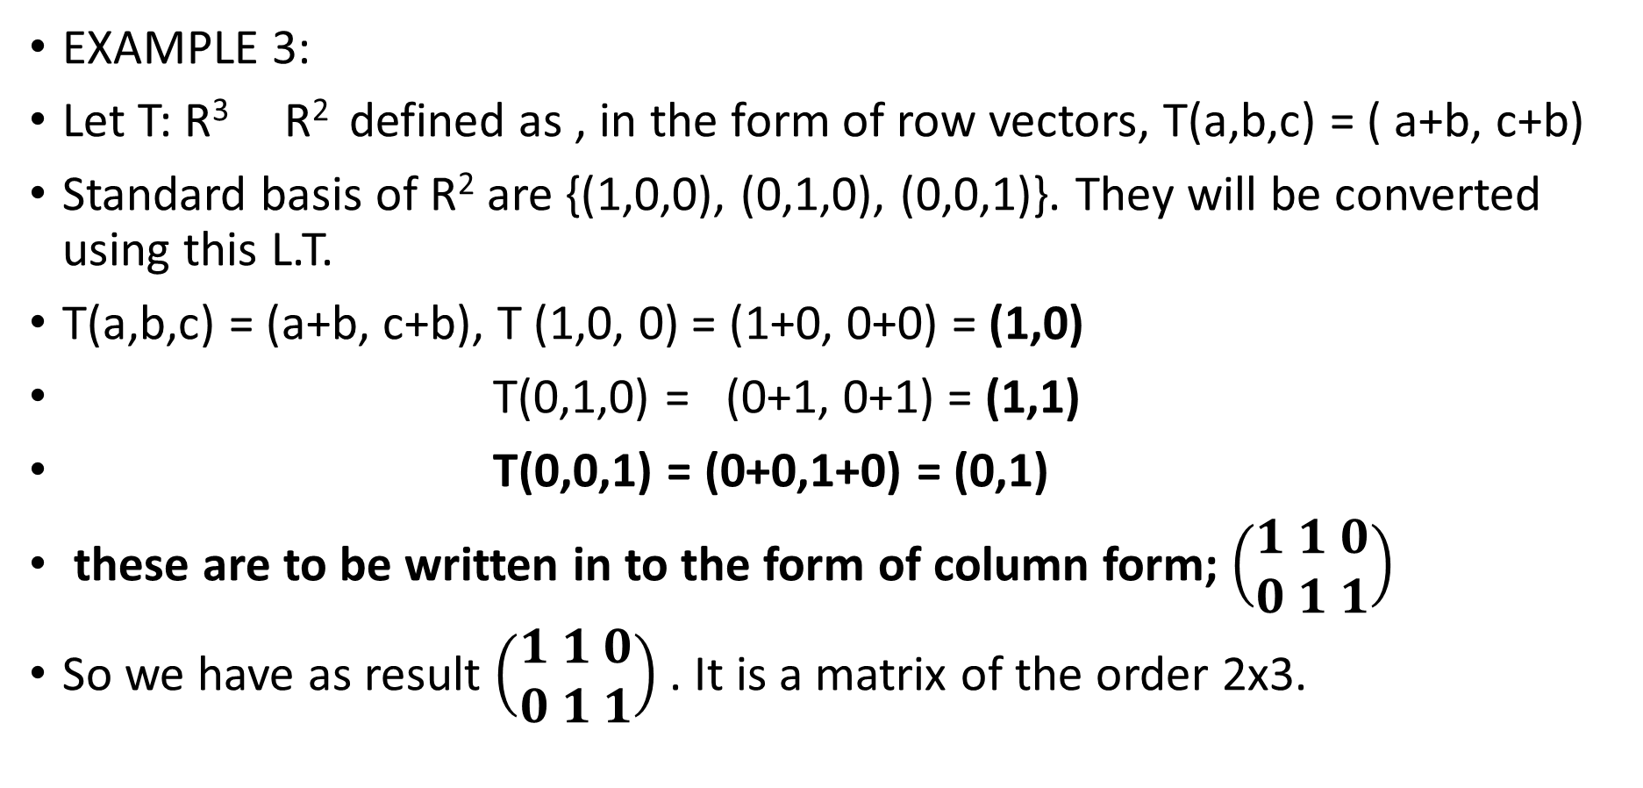
LALP 2.19
EXAMPLE 3:
Let T: R³ R² defined as , in the form of row vectors, T(a,b,c) = ( a+b, c+b)
Standard basis of R² are {(1,0,0), (0,1,0), (0,0,1)}. They will be converted using this L.T.
T(a,b,c) = (a+b, c+b), T (1,0, 0) = (1+0, 0+0) = (1,0)
T(0,1,0) = (0+1, 0+1) = (1,1)
T(0,0,1) = (0+0,1+0) = (0,1)
these are to be written in to the form of column form; $\left(\begin{matrix}1 \\ 0\end{matrix} \begin{matrix}1 \\ 1\end{matrix} \begin{matrix}0 \\ 1\end{matrix}\right)$
So we have as result $\left(\begin{matrix}1 \\ 0\end{matrix} \begin{matrix}1 \\ 1\end{matrix} \begin{matrix}0 \\ 1\end{matrix}\right)$ . It is a matrix of the order 2x3.

Slide 21
LALP 2.20
Matrix is a result of linear transformation on the basis of the domain set.
It is written as (T: B1, B2) where B1 and B2 are standard basis of the domain and codomain.
There may be different basis of domain and codomain also.
Assignment 1:
Ex-1 Determine the matrix associated with T(a,b) = ( a a+b)
Ex-2 Determine the matrix associated with T(a,b) = ( a a+b, a-b)
Ex-3 Determine the matrix associated with T(a,b,c) = ( 2a a+b, a-b)
Ex-4 Determine the matrix associated with T(a,b,c) = ( 2a+c, c+b)
Ex-5 Determine the matrix associated with T(a,b, c,d ) = ( a+d, b+c, d+c+a)

